Slide 1
Metric System
Meters, Liters, and Grams – OH MY!

Slide 2
Learning Objectives
I can describe why the metric system is so easy to use.
I can list the standard units for the metric system.
I can describe how things are measured in the metric system.
I can explain what a standard is.
I can explain the advantages of using the metric system.

Slide 3
What is the Metric System?
How everyday things are measured …
DISTANCE
VOLUME
MASS

Slide 4
Why is it so easy to use?
It is based on 10’s

Slide 5
What are the other names of the metric system?
International system of units
System International (SI) for short

Slide 6
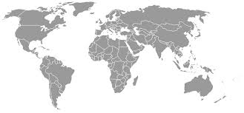
Used everywhere but the USA!
And Burma

Slide 7
What are the advantages of the metric system?
Based on 10’s
Easier to convert
Easier to share results
Easier to compare results

Slide 8
What is a standard
Something that never changes
Meter standard – The speed of light in vacuum during a time interval of 1299 792 458 of a second

Slide 9
Name the standard
Length -
Mass -
Liquid Volume -
Temperature -
Time -
Meter
kilogram
Liter
Kelvin
second

Slide 10
Base Units
There are 3 important base units
Volume = Liter (L)
Mass = Gram (g)
Length = Meter (m)

Slide 11
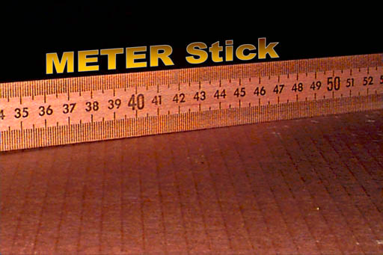
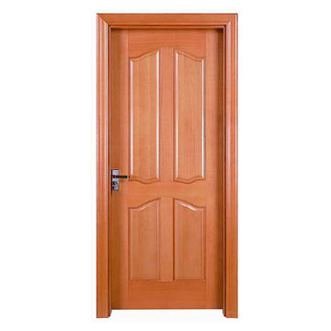
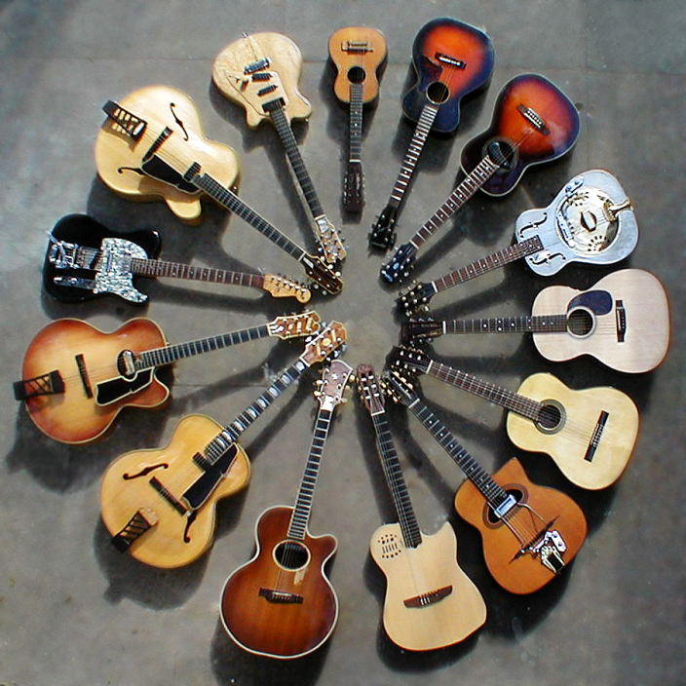
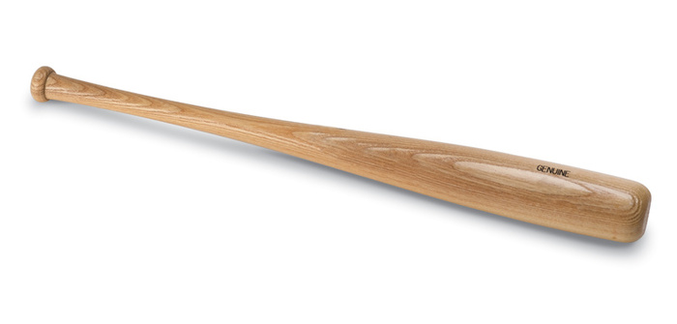
Meter

Slide 12
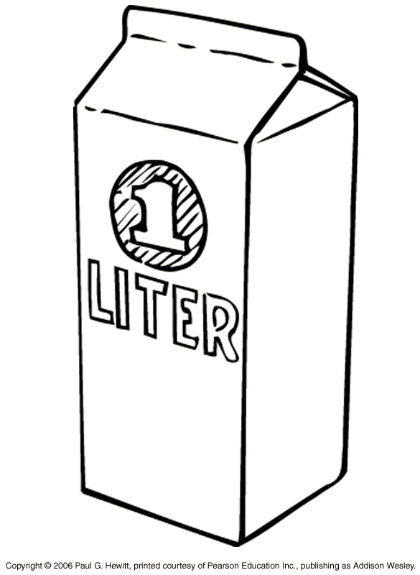
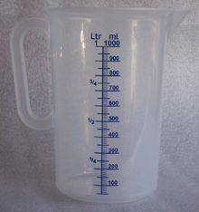
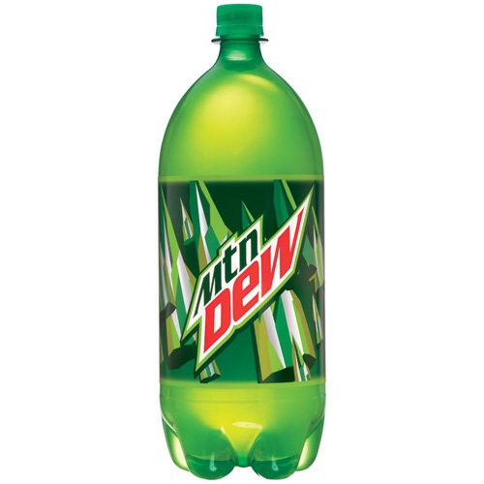
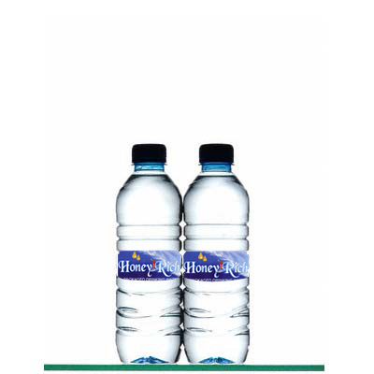
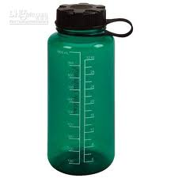
Liter
Two Liters

Slide 13
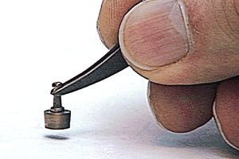
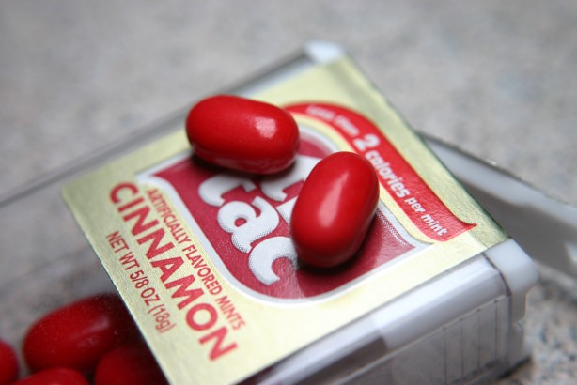
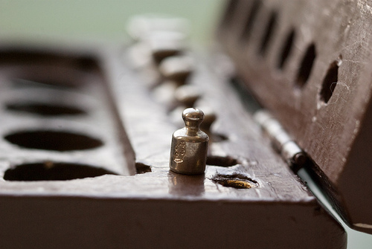
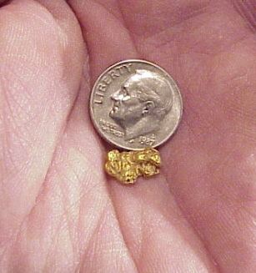
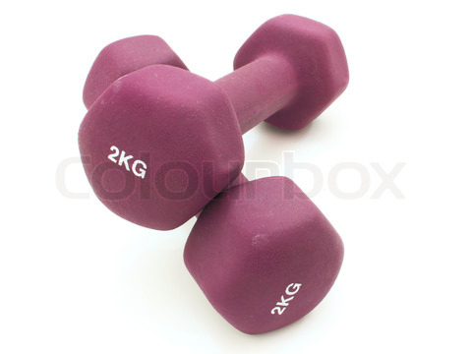
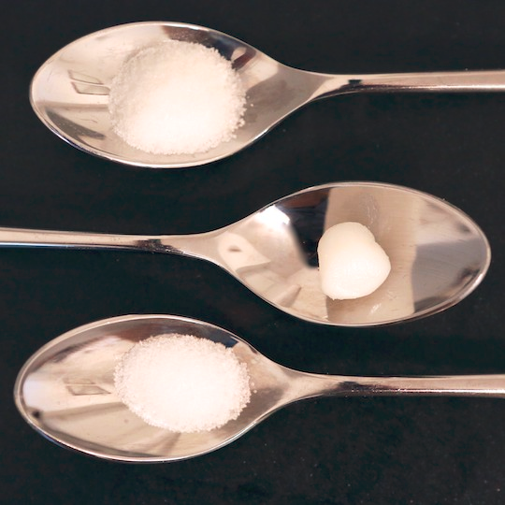
Gram
$42
Salt
Lard
Sugar

Slide 14
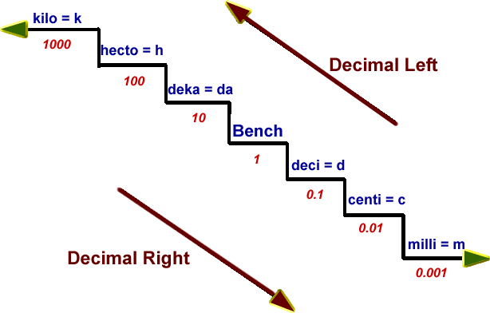
Metric prefixes change the value
(Meter, Liter Gram)

Slide 15
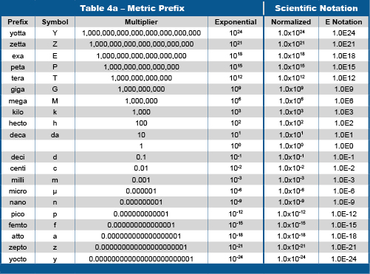

Slide 16
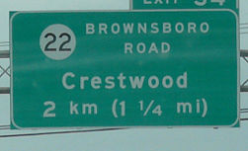
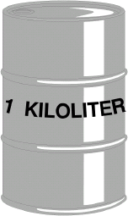
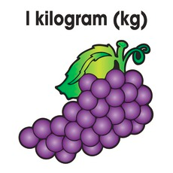
Kilo = 1000
1 kilometer = 1000 meters
1kiloliter = 1000 liters
1 kilogram = 1000 grams

Slide 17
Centi = .01 or 1/100
1 meter = 100 centimeters
1 liter = 100 centiliters
1 gram = 100 centigrams

Slide 18
Big Ideas
Metric system is easy to use because it is based on 10’s.
Standard units for the following are:
  Mass – kilogram
  Volume – Liter
  Length – Meter
  Temperature – Kelvin
  Time – second
The advantages of the metric system are:
  Easier to convert
  Share and compare results

